Slide 1
Recap
Heading
Paragraph
Image
Anchor
Table
hr
List

Slide 2
Introduction to CSS

Slide 3
Ways to insert CSS
Three Ways to Insert CSS
Inline CSS
Internal CSS
External CSS

Slide 4
What is CSS?
Attribute Selector
Element Selector
ID Selector
Class Selector
Generic Selector

Slide 5
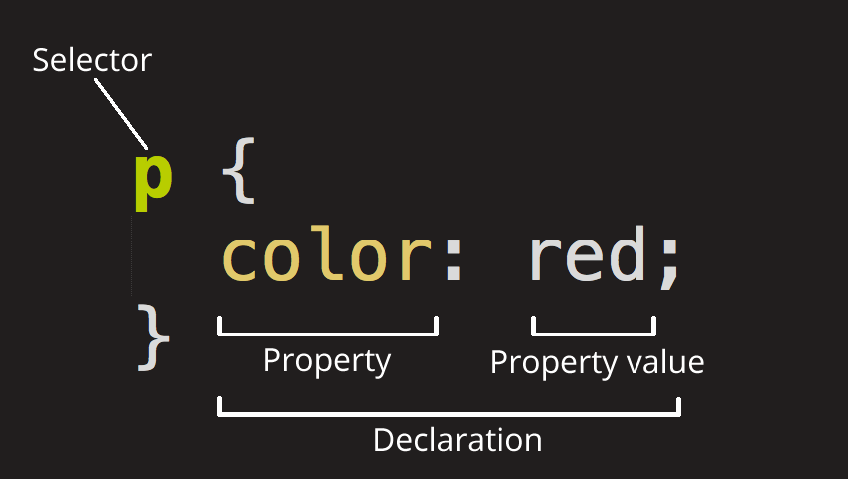
What is CSS?

Slide 6
Comments

Slide 7
Cascade in CSS

Slide 8
Specificity in CSS

Slide 9
CSS Inheritance

